Slide 1
Trait theories
Anoosha Rehan
Lecturer, FAST NUCES, CFD

Slide 2
Early Trait Theories
The trait approach to personality is one of the major theoretical areas in the study of personality.
Trait approaches have tried to identify the most basic and relatively enduring dimensions along which people differ from one another - dimensions known as traits.
Trait approach to personality is focused on differences between individuals.
It is focused on identifying and measuring these individual personality characteristics.
Trait
A trait is a stable personality characteristic
(Cacioppo & Freberg, 2013)

Slide 3
Early Trait Theories
Trait
A trait is a stable personality characteristic.
A trait is a personality characteristic that meets three criteria: it must be consistent, stable, and vary from person to person.
If someone asked you to describe a close friend's personality, what kind of things would you say? A few things that might come to mind are descriptive terms such as "outgoing," "kind" and "even-tempered." All of these represent traits.

Slide 4
Trait Theories
1. Gordon Allport’s Trait Theory
2. Raymond Cattell’s Sixteen Personality Factor
3. Eysenck’s Three Dimensions of Personality
4. The Big Five Theory/ Five-Factor Model

Slide 5
1. Gordon Allport’s Trait Theory
In 1936, psychologist Gordon Allport found that one English language dictionary alone contained more than 4,000 words.
Describing different observable personality traits. He categorized these traits into three levels.
Three trait theory
1. Cardinal Traits: Traits that dominate an individual’s whole life, often to the point
that the person becomes known specifically for these traits. Freudian,
Machiavellian, narcissism, Don Juan, Christ-like, etc.

Slide 6
1. Gordon Allport’s Trait Theory
1. Cardinal Traits: Traits that dominate an individual’s whole life, often to the point that the person becomes known specifically for these traits. Freudian, Machiavellian, narcissism, Don Juan, Christ-like, etc.
Altruism: Mother Teresa is an example of a person whose cardinal trait was altruism. Her entire life was dedicated to helping and caring for the poor and sick, and this trait defined her existence.

Slide 7
Allport’s Trait Theory
2. Central Traits: These are the general characteristics that form the basic foundations of personality. While central traits are not as dominating as cardinal traits, they describe the major characteristics you might use to describe another person. Terms such as intelligent, honest, shy and anxious are considered central
traits.
Honesty: An individual who is consistently truthful, reliable, and sincere in their interactions can be described as having the central trait of honesty.
Friendliness: Someone who is generally approachable, sociable, and welcoming to others demonstrates the central trait of friendliness.

Slide 8
Allport’s Trait Theory
3. Secondary Traits: These are the traits that are sometimes related to attitudes or preferences and often appear only in certain situations or under specific circumstances. These are situational and less consistent traits. Examples would be getting anxious when speaking to a group or impatient while waiting in line.
Shyness: Even an outgoing person may experience shyness when meeting new people or speaking in public.
Nervousness: Someone who is typically confident may display nervousness before a job interview or during an important presentation.

Slide 9
2. Raymond Cattell’s Sixteen Personality
Factor (16-PF)
Trait theorist Raymond Cattell reduced the number of main personality traits from All port’s initial list of over 4,000 down to 16 which he believed represented the core traits of human personality.
He did so by means of a statistical technique called factor analysis.
These factors include traits like warmth, reasoning, emotional stability, and dominance.
Cattell's goal was to provide a more comprehensive and detailed description of personality compared to earlier theories.

Slide 10
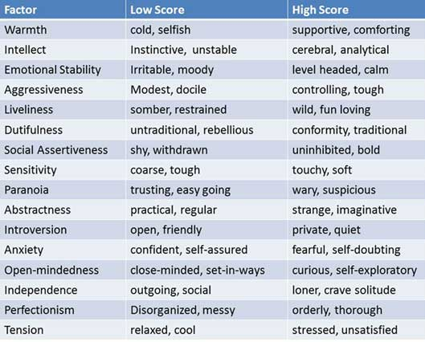
Cattell’s 16-PF

Slide 11
3. Eysenck’s Three Dimensions
(PEN Model) of Personality
PEN model is a biological theory of personality developed by influential psychologist Hans Eysenck (1916-1997). The model focusses on three broad personality factors: Psychoticism, Extraversion and Neuroticism (PEN).
Prior to developing the PEN model, Eysenck sought to measure personality based on two dimensions: extraversion-introversion and neuroticism-emotional stability.
Extraversion (E): This dimension reflects the extent to which individuals are outgoing, sociable, and assertive versus reserved and introverted. High extraversion is associated with characteristics like talkativeness, enthusiasm, and a preference for social interactions.
Neuroticism (N) or Emotional Stability: Neuroticism measures emotional stability versus emotional instability. Individuals high in neuroticism tend to experience negative emotions like anxiety, moodiness, and irritability more frequently.
Psychoticism (P): The third dimension, psychoticism, captures qualities like aggressiveness, risk-taking, and a lack of empathy. High scores on this dimension may indicate a tendency toward antisocial or impulsive behaviors.

Slide 12
3. Eysenck’s Three Dimensions
(PEN Model) of Personality
Extraversion (E): This dimension reflects the extent to which individuals are outgoing, sociable, and assertive versus reserved and introverted. High extraversion is associated with characteristics like talkativeness, enthusiasm, and a preference for social interactions.
Neuroticism (N) or Emotional Stability: Neuroticism measures emotional stability versus emotional instability. Individuals high in neuroticism tend to experience negative emotions like anxiety, moodiness, and irritability more frequently.
Psychoticism (P): The third dimension, psychoticism, captures qualities like aggressiveness, risk-taking, and a lack of empathy. High scores on this dimension may indicate a tendency toward antisocial or impulsive behaviors.

Slide 13
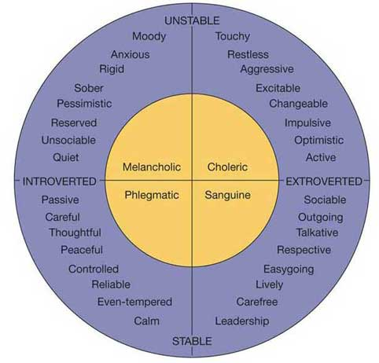
Eysenck’s Three Dimensions (PEN Model) of Personality
Hans Eysenck:
found two (2) major
trait dimensions:
  Introversion
  versus
  extroversion/ extraversion
  (quiet versus sociable).
  Neuroticism
  versus
  emotional stability
  (moody versus calm).

Slide 14
Eysenck’s Three Dimensions of Personality
Extroverts are sociable and crave excitement and change, and thus can become bored easily. They tend to be carefree, optimistic and impulsive. They are more likely to take risks and be thrill seekers. Eysenck argues that this is because they inherit an under aroused nervous system and so seek stimulation to restore the level of optimum stimulation.
Introverts on the other hand lie at the other end of this scale, being quiet and reserved. They are already over-aroused and shun sensation and stimulation. Introverts are reserved, plan their actions and control their emotions. They tend to be serious, reliable and pessimistic.

Slide 15
Eysenck’s Three Dimensions of Personality
Extraversion: An individual who enjoys going to social events, parties, and gatherings frequently. They often initiate conversations, make new friends easily, and feel energized in social settings. For example, someone who regularly hosts dinner parties and enjoys meeting new people.
Introversion: A person who prefers quiet evenings at home, reading a book, or working on solitary hobbies like painting or writing. They may have a few close friends but are selective about social engagements. For example, someone who finds solitude and introspection refreshing and recharging.

Slide 16
Eysenck’s Three Dimensions of Personality Neuroticism (Emotional stability)
High Neuroticism/ Emotionally Instable
It is characterized by perfectionism, and a tendency to feel dissatisfied, angry or frustrated with others when their desires are not fulfilled, or when their expectations are not met.
Individuals scoring high on neuroticism measures tend to experience higher levels of stress and anxiety. They worry about relatively insignificant matters, exaggerating their significance and feeling unable to cope with life stressors.
Low Neuroticism / Emotionally Stable
A person with a low neuroticism score will generally experience more emotional stability. They feel more able to cope with stressful events and set less stringent demands of themselves.
Individuals with a low level of neuroticism are more tolerant of the failings of others and remain more calm in demanding situations.

Slide 17
Eysenck’s Three Dimensions of Personality
High Neuroticism: An individual prone to experiencing intense and frequent negative emotions. They may worry excessively, get anxious in various situations, and have mood swings. For example, someone who becomes extremely anxious before taking a flight and experiences mood swings when facing minor setbacks.
Low Neuroticism: A person who remains calm under pressure, handles stress well, and maintains a generally positive and even-tempered demeanor. They tend to be resilient in the face of challenges. For example, someone who remains composed during a crisis and approaches difficulties with a sense of control.

Slide 18
Eysenck’s Three Dimensions of Personality
Psychoticism (Tough-mindedness)
High Psychoticism (tough-minded)
Eysenck (1966) later added a third trait / dimension -Psychoticism – e.g., lacking in empathy, cruel, a loner, aggressive and troublesome. Individuals with higher psychoticism scores are more likely to engage in irresponsible or miscalculated behavior. They may also contravene accepted social norms and be motivated by a need for immediate gratification, regardless of its consequences.
An individual who displays qualities like aggressiveness, a lack of empathy, and a willingness to take risks. They may not be easily swayed by emotional appeals and may prioritize logical thinking over emotional considerations. For example, someone who excels in high-stakes, competitive fields like finance or law enforcement.

Slide 19
Eysenck’s Three Dimensions of Personality
Psychoticism (Tough-mindedness)
Low Psychoticism/ Normality (tender-minded)
A person who values empathy, compassion, and cooperation. They are considerate of others' feelings, avoid confrontation, and may be more sensitive to emotional nuances in interpersonal relationships. For example, someone who works in a caring profession like counseling or social work.

Slide 20
4. The Big-Five Theory/ Five-Factor Model
Presented by McCrae and Costa in 1987
Many researchers felt that Cattell's theory was too complicated and Eysenck's was too limited in scope. As a result, the five-factor theory emerged to describe the essential traits that serve as the building blocks of personality.
The five broad personality traits described by the theory are extraversion (also often spelled extroversion), agreeableness, openness, conscientiousness, and neuroticism.

Slide 21
4. The Big-Five Theory/ Five-Factor Model
Extraversion: The degree to which individuals are outgoing, sociable, and assertive versus reserved and introverted.
High Extraversion: Sarah is the life of the party. She loves going to social gatherings, meeting new people, and engaging in lively conversations. She's often the first to initiate plans for group outings and is energized by social interactions.
Low Extraversion: James is introverted and enjoys spending evenings at home with a good book. He prefers one-on-one conversations over large gatherings and finds solitude refreshing.

Slide 22
4. The Big-Five Theory/ Five-Factor Model
Agreeableness: The extent to which people are cooperative, friendly, and compassionate versus competitive and antagonistic.
High Agreeableness: Lisa is known for her warmth and kindness. She's always willing to help others, often volunteers in her community, and goes out of her way to make people feel comfortable and valued.
Low Agreeableness: Mark can be competitive and argumentative. He's driven by a desire to succeed and may prioritize his own goals over the feelings and needs of others.

Slide 23
4. The Big-Five Theory/ Five-Factor Model
Conscientiousness: The level of organization, responsibility, and dependability versus impulsiveness and carelessness.
High Conscientiousness: Emily is exceptionally organized and responsible. She keeps meticulous to-do lists, meets deadlines ahead of time, and ensures that every task she takes on is completed to the highest standard.
Low Conscientiousness: John tends to be more impulsive and disorganized. He may procrastinate on tasks, frequently overlook details, and struggle with time management.

Slide 24
4. The Big-Five Theory/ Five-Factor Model
Neuroticism (Emotional Stability): The degree of emotional stability versus emotional instability, anxiety, and moodiness.
High Neuroticism: Rachel often experiences intense anxiety, even in relatively calm situations. She is quick to become upset by minor setbacks and can have mood swings that affect her daily life.
Low Neuroticism: Tom remains calm and composed under stress. He rarely gets flustered by unexpected challenges and maintains a consistently positive and even-tempered demeanor.

Slide 25
4. The Big-Five Theory/ Five-Factor Model
Openness to Experience: The willingness to explore new ideas, experiences, and creativity versus being conventional and close-minded.
High Openness: Alex is a creative thinker who embraces new ideas and loves to explore diverse cultures. He enjoys trying new cuisines, engaging in artistic endeavors, and frequently seeks out new experiences and challenges.
Low Openness: Sarah prefers routine and familiarity. She tends to be more traditional in her thinking, avoids risk-taking, and may be less interested in trying novel activities or unconventional ideas.

Slide 26
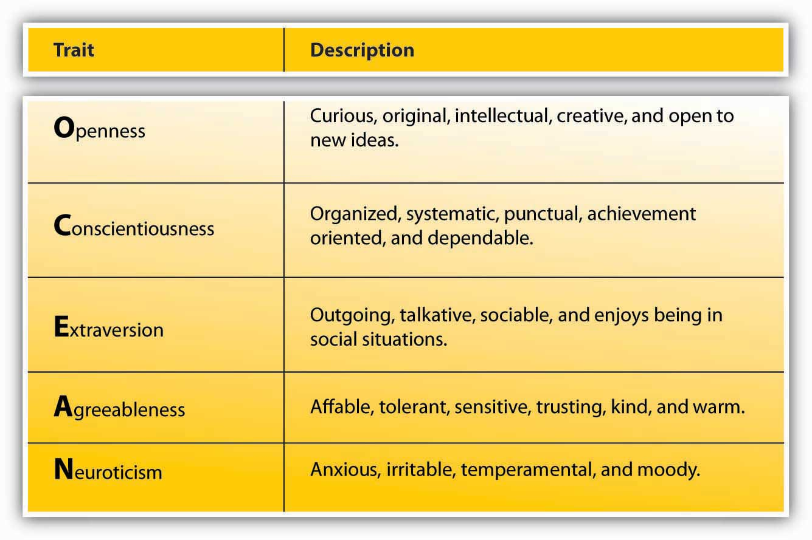
The Big-Five Theory/ Five-Factor Model

Slide 27
Thank you!

